Slide 1

ESport Betting DApp with Betting Insurance
CoFounders: Ran Wang, Mingze Shi, Ishu Jaswani, Shengzhi Wang

Slide 2
Project Idea
Who are we?
“ESport Betting DApp with Betting Insurance”
We are online bookmakers that integrate blockchain technology and crypto currencies to change the Esport Betting Industry
What is the problem?
Blooming Market
Unsatisfied Needs
Esport Betting: Controversy around age and regulations

Slide 3
Market Analysis
Total Available Market: 2.7 billion
Target Audience and games:
Most popular games for betting: League of Legends, Dota, and CS:GO
Most active age group for betting: 18-25 year olds
Market Share:
Market share: 9.7B in 2021, 13.7% CAGR to reach 24B in 2028.
Total number of Esports Viewers are 489.5 million
Serviceable Available Market: 116 million
Target market :93 Million

Slide 4
Product Idea-MVP
Product Functions:
betting on Esports
the winners, scores, match durations, and more
introduce betting insurance
MVP:
bet on Winners in One game
with insurance
Insurance:
works only if bettors guess wrong
additional conditions should be meet
chance to get some money back
(always more than insurance cost)

Slide 5
Product Idea-MSD
Function:
Allow users to place bets on esports matches using a smart contract
Purpose:
Transparent
Decentralized
Secure

Slide 6
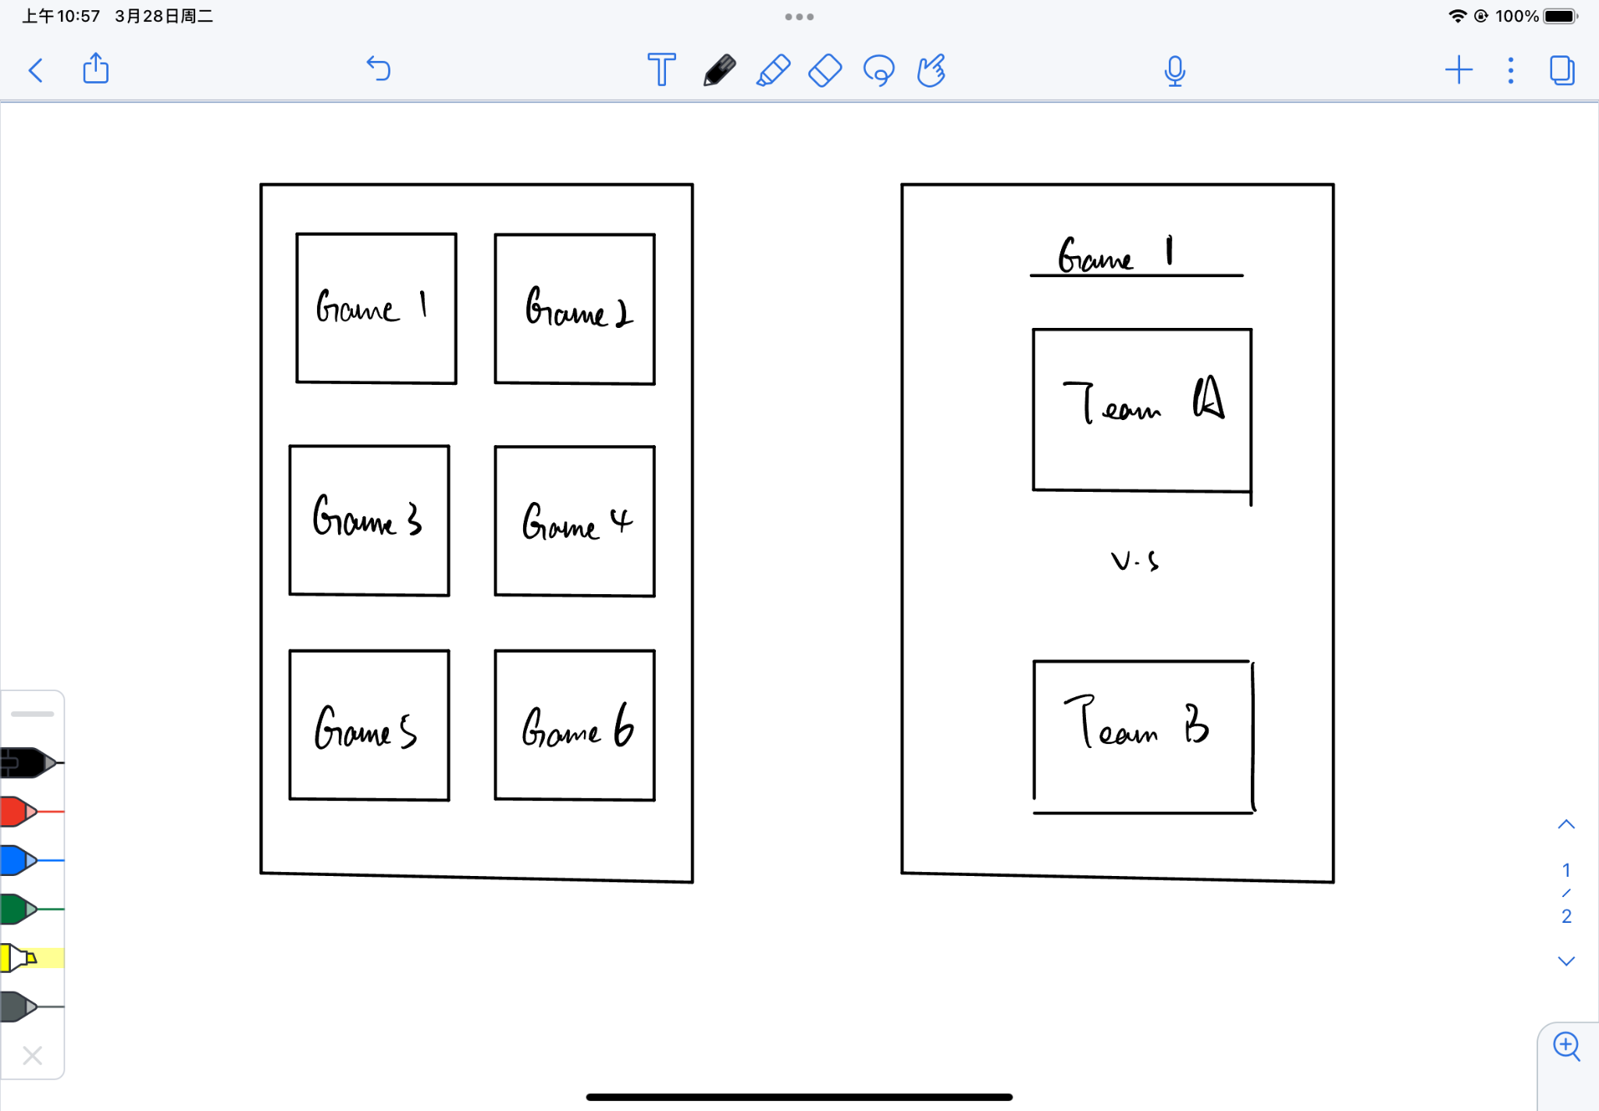
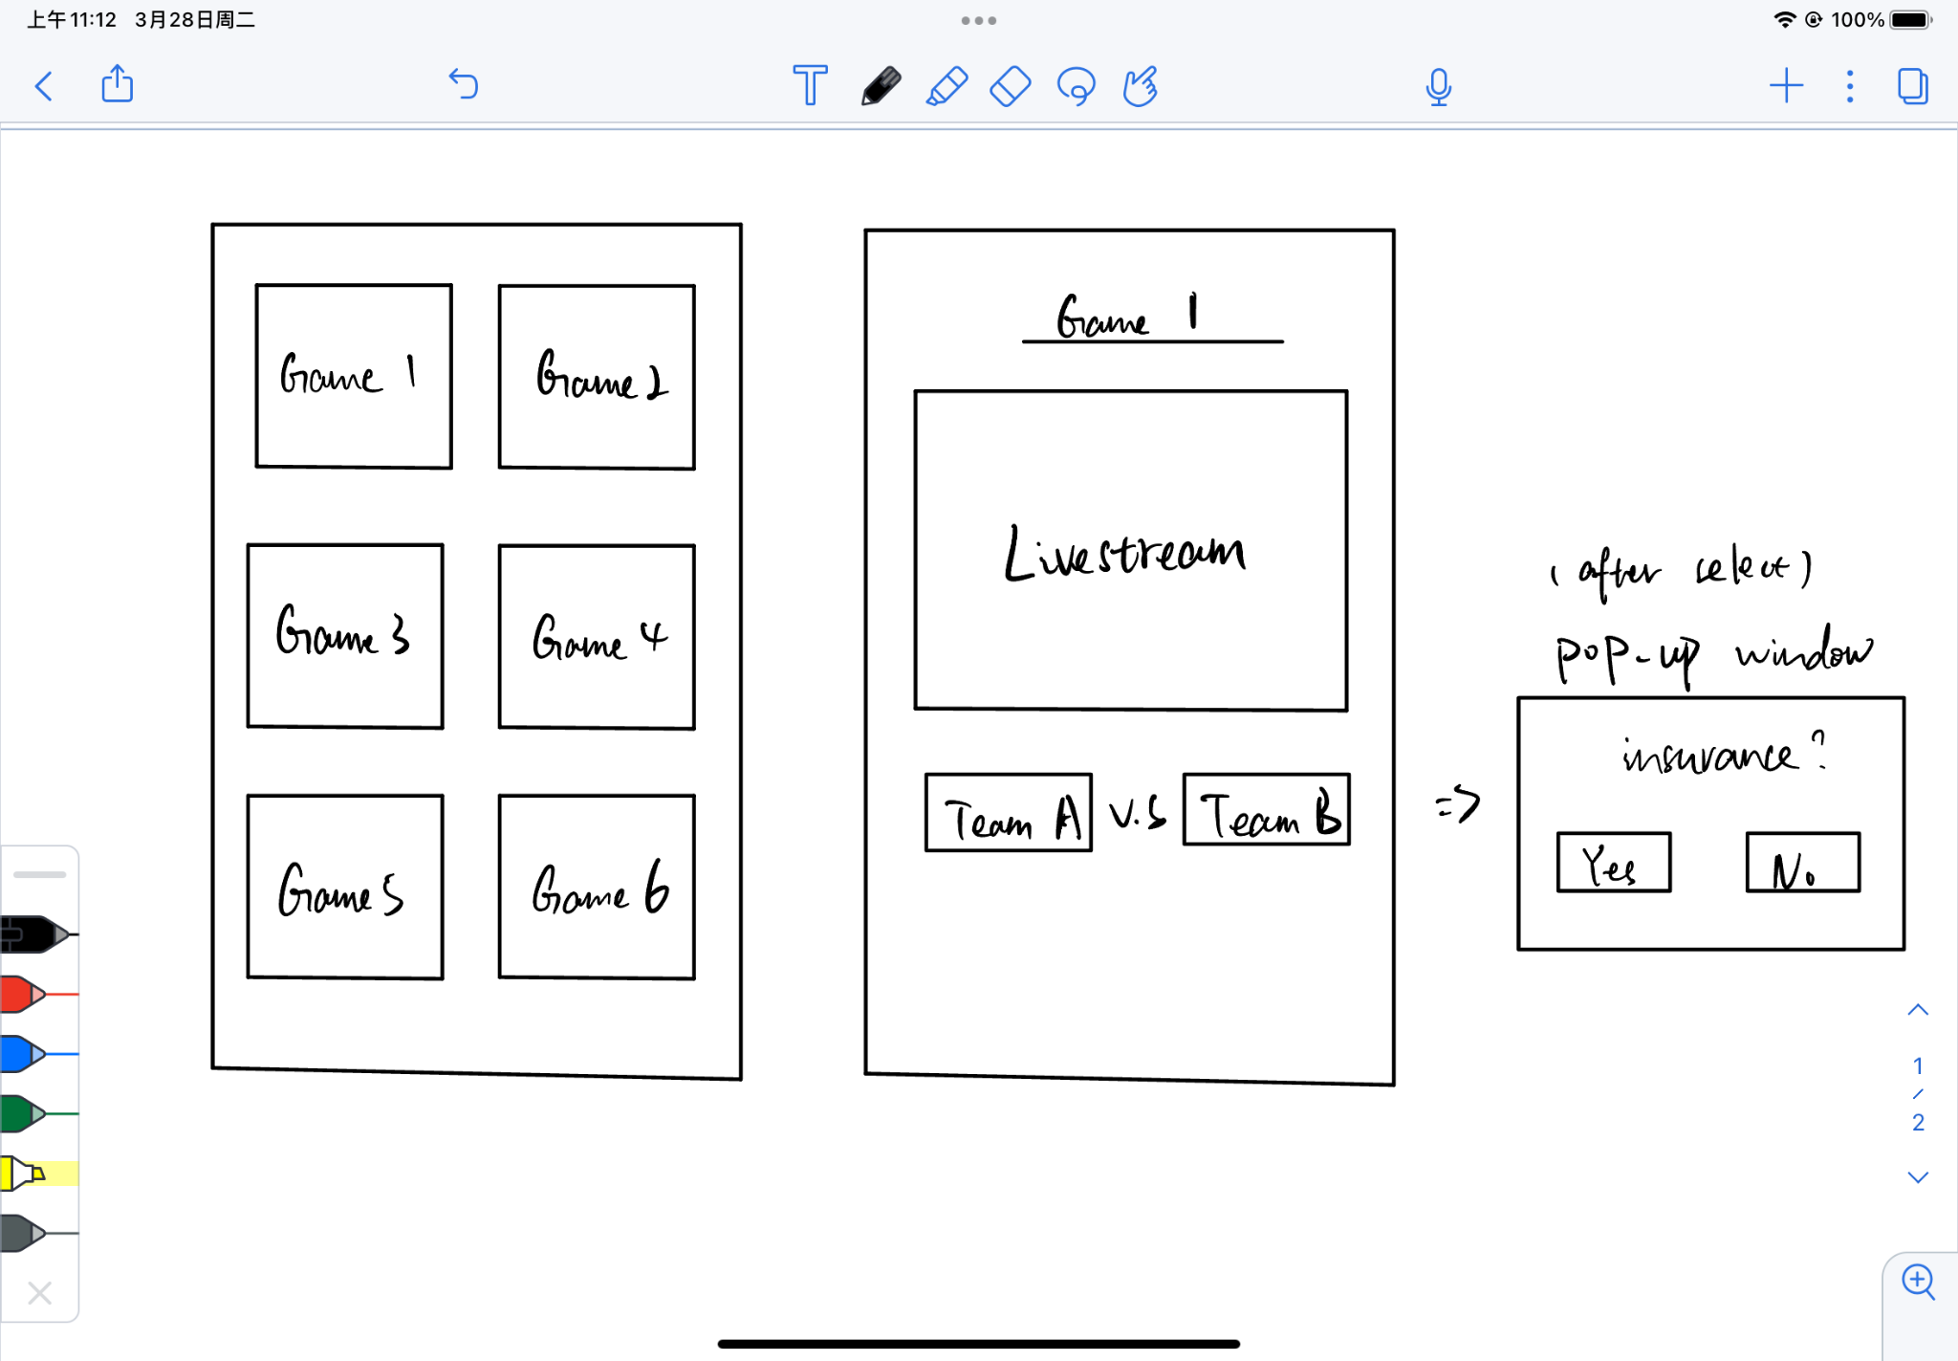
User Interface
Initial Draft:

Slide 7
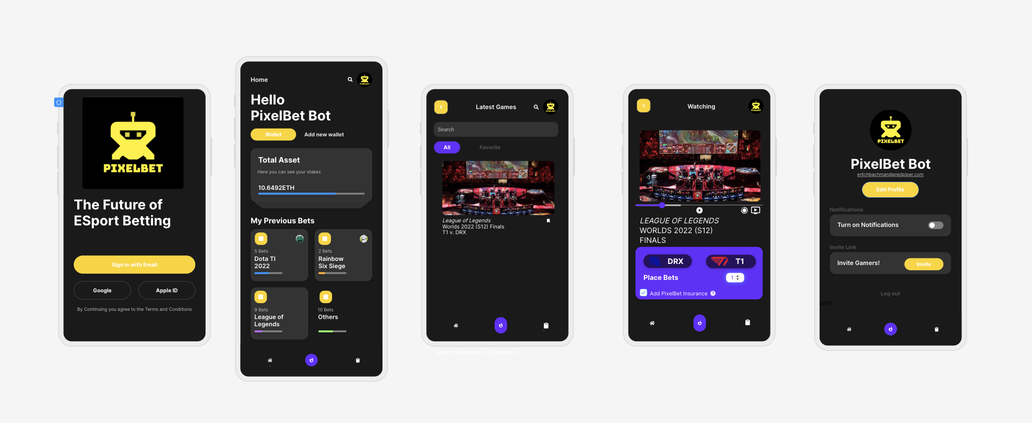
User Interface: A Step-Up

